Slide 1
AZ-900 Study Primer Takeaways
Box Folder of Study Materials
https://ibm.box.com/s/oohpqmdsv2nvpzwifp5r0pqw8o7vii1o
Get your Azure Free Account
https://azure.microsoft.com/en-us/free/

Slide 2
Get Voucher
September 15 - Request a Voucher to take the Cert Test of your choice. I will be circulating around to check on you between now and this time.
October 15 - Schedule a specific Test Date for that Cloud Certification (gives you a month to receive your voucher and to study for the exam).
November 15 - the last day to take the Cloud Certification of your choice.
Look at this website for instructions on the specific certification you are targeting: https://w3.ibm.com/w3publisher/gbs-na-l-k-multicloud-enablement
You will find this information in the link in step 2, but when you're ready to take a certification (other than Azure), you request it at LRT -
https://lrt.yourlearing.ibm.com

Slide 3
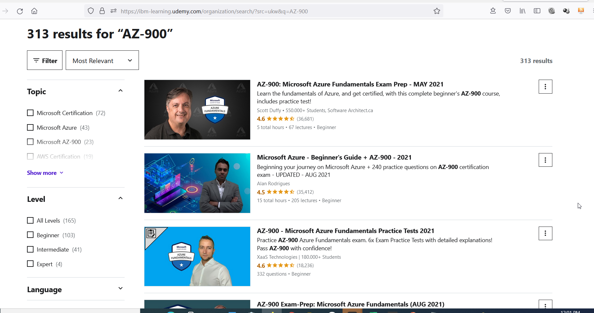

Slide 4
THINGS THAT YOU CAN ABSOLUTELY COUNT ON AS TRUE
IaaS - Virtual Machine or anything that requires storage (VM, or diskspace)
You are installing your own software which you purchased (Azure provides the Infrastructure – ie Hardware, DC)
PaaS - Any DB system, ex Azure SQL, Cosmos, WebApps, Application Service (AZure provides Platform – ie Windows/Linux)
SaaS - only configure software, cannot install, cannot change OS, or change resources CPU, instances
WHEN CONNECTED TO THE CLOUD - Cloud Shell can do anything
          Web Console Can do anything
  PowerShell script requires Powershell CLI (except Powershell scripts can run on CloudShell)
        CLI (Command Line Interface aka DOS)
        Know which console, powershell or other you are being asked to use
NO CHARGE TO TRANSFER DATA UP TO CLOUD – WHY? DOUBLE DIPPING, THEY CHARGE YOU TO STORE IT.
ALWAYS CHARGE TO TRANSFER DATA DOWN FROM CLOUD
DATABASE DATA MART/ DATA WAREHOUSE LAKE
Relational Tables GROUPS oF Relational Tables or DBs Lots of diff types of Data
HOMOGENEOUS(Similar) HOMOGENEOUS (similar) NOT HOMOGENOUS (dissimilar)
NSG - NETWORK SECURITY GROUP network routes mapping and FW IPs
        192.168.1.1 -> access only locally
        Open Port 80 443 -> public ip to private ip so internet can communicate HTTP – port 80, HTTPS – port 443
AVAILABILITY ZONES ALWAYS IN A SINGLE REGION

Slide 5
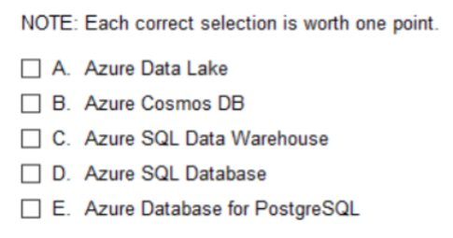
As you come across an answer set:
Build you a sheet containing definitions of each of these answers
Try to find Key Words:
For example: SQL will imply Relational DB where others are NoSQL
or Data Warehouse or Data Lake implies LARGE storage

Slide 6
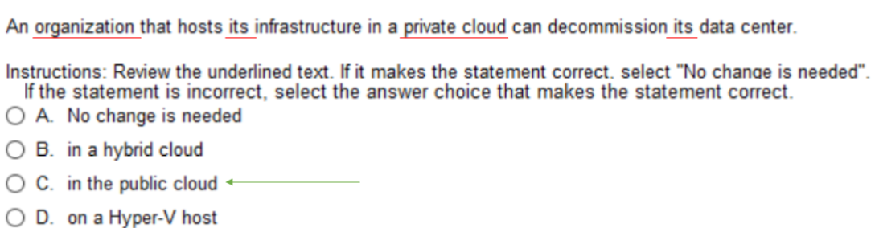
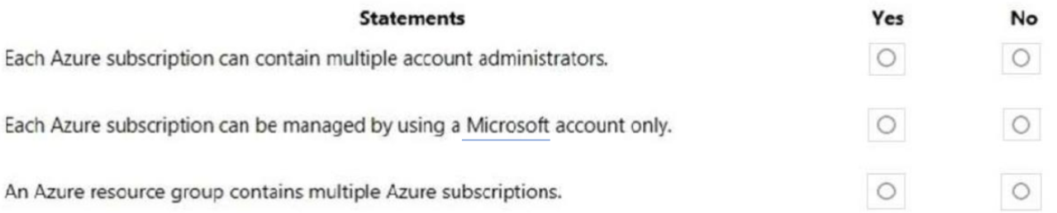
When you come across these questions:
Explain why one answer is NOT the answer
Or Why this might be a BETTER answer

Slide 7
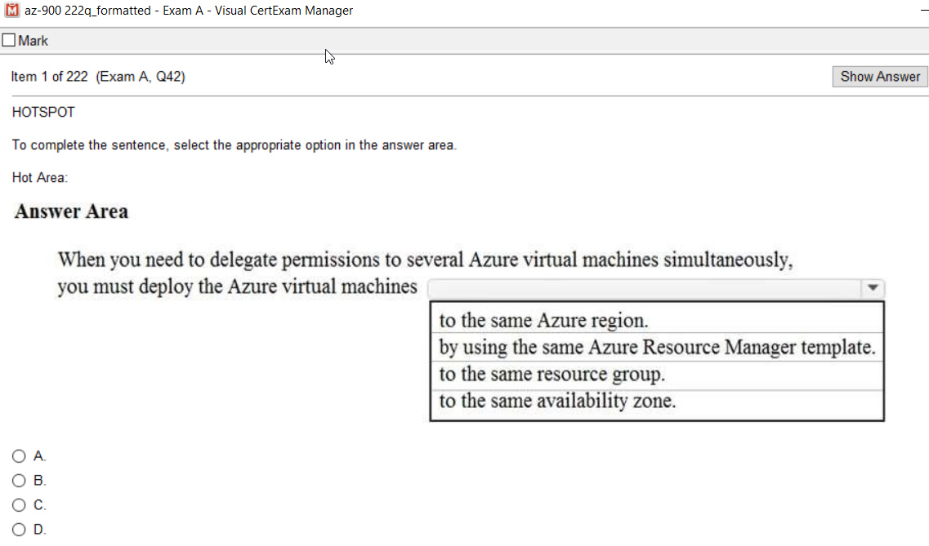
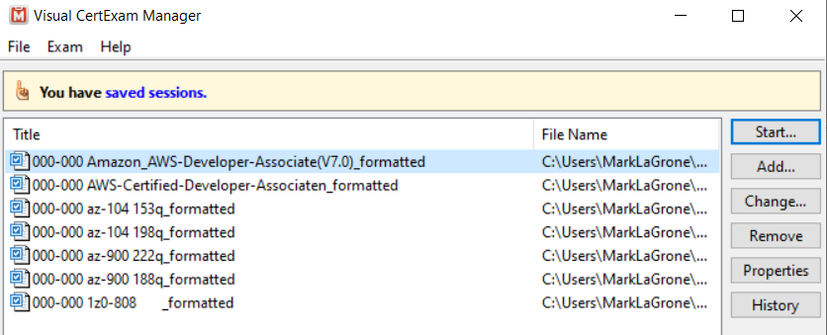
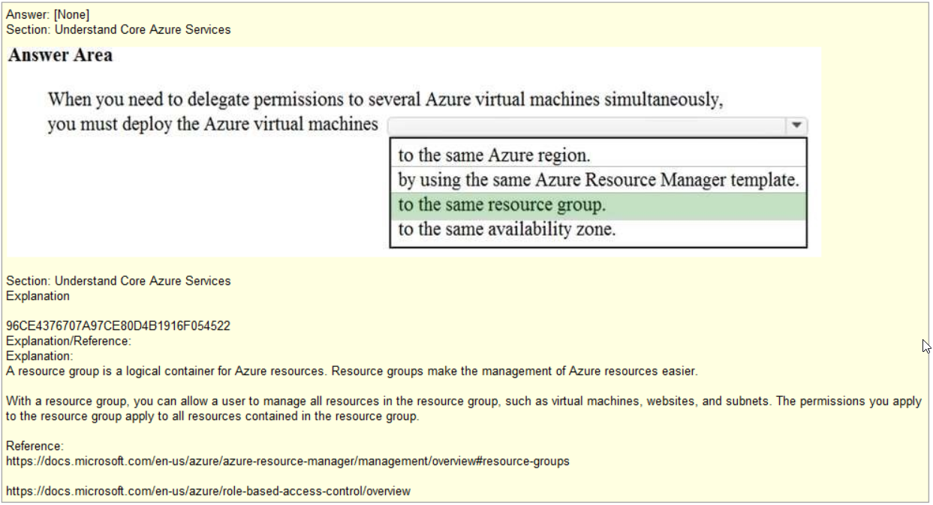
Do the Simulator:

Slide 8
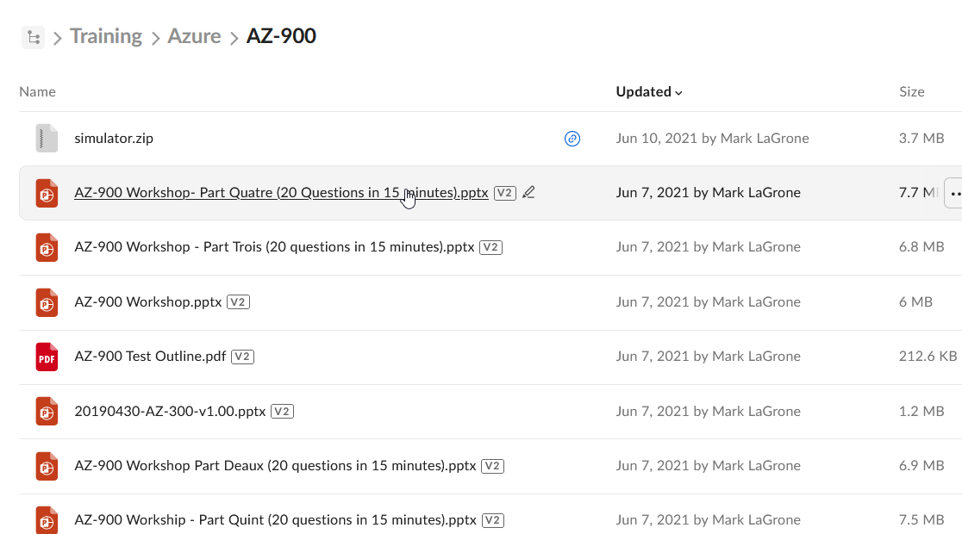
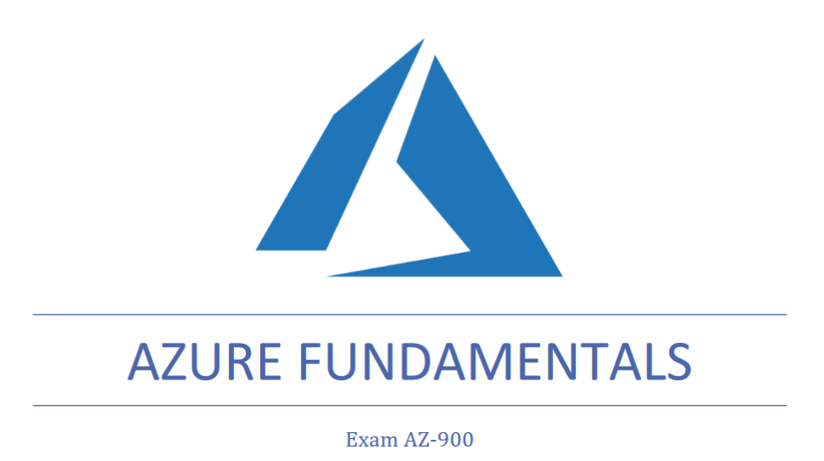
Box Folder Resources:
https://ibm.box.com/s/oohpqmdsv2nvpzwifp5r0pqw8o7vii1o
Simulator
PPTXs

Slide 9
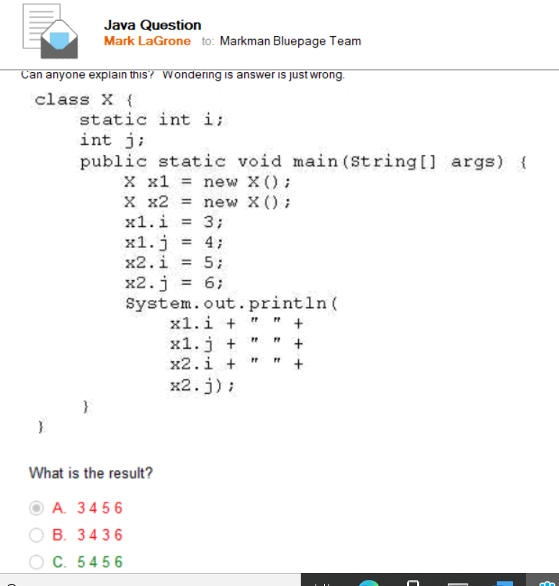
APPENDIX
Don't understand something,
Ask somebody who already
passed it
We obviously need more of you ttl
Esther Kinsougbo
Blackledge, Ella
Kiran Gurung
Christopher Standbury Mark LaGrone
Example: I am studying for Java Cert test. When I don't understand, I send it to the team asking for an explanation

Slide 10
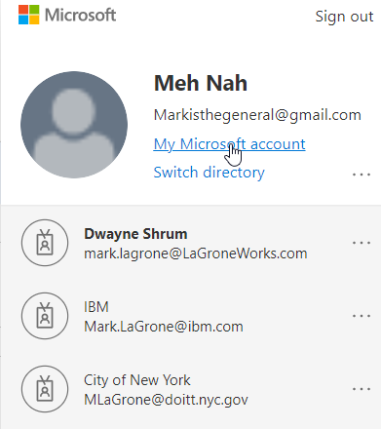
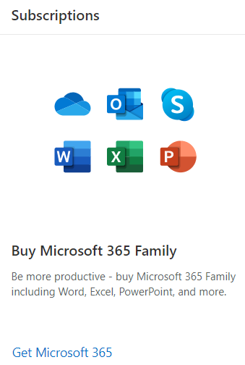
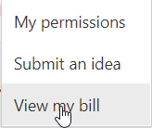
Tenant vs Subscription
3 Different Tenants
Subscriptions - allow AD or AD authenticated users/accounts access to certain components/features.
Access Policy determines what subscription has authentication while authorization to which components

Slide 11
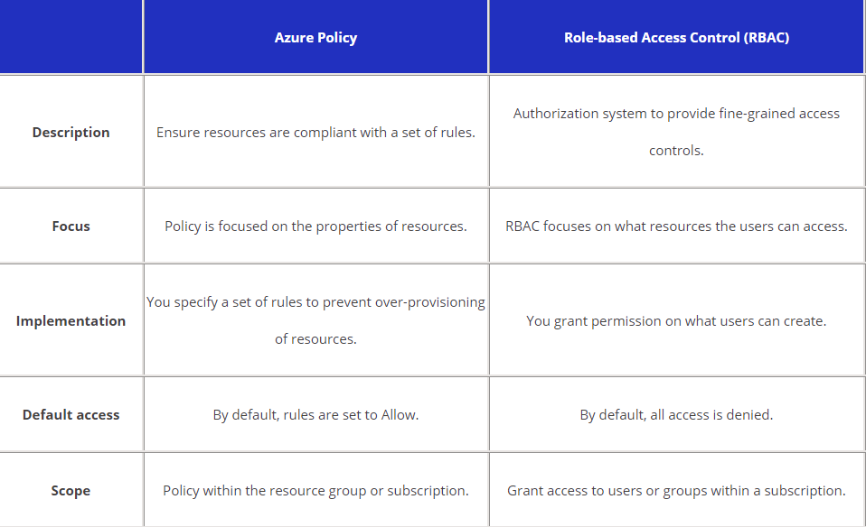
POLICIES vs ROLES vs SERVICES
POLICY
ROLES
SERVICES
Privileged Identity Management (PIM)
-provide/restrict to as-needed and just-in-time access
to Azure resources, Azure AD resources,
and other Microsoft online services like Microsoft 365
-Force Password change if coming in from certain location
-Prevent login from certain IP range (known rogue states)
Azure Information Protection
-hides or redacts PII (Ie SSN or CC info from display
in documents) or blocks from being transmitted
outside organization
Azure Multi-Factor Authentication (MFA)
-Enforce/require it
-Login and Email code or phone call
authenticator app to verify authentication
Policy Examples:
Force password change after 45 days
Require MFA
This subscription has access to these
resource (VM, MS project) types,
but not those MS Dynamics, PowerBI
Role Based Examples:
Give Marketing to manage this webapp
Give Terrie access to this VM

Slide 12
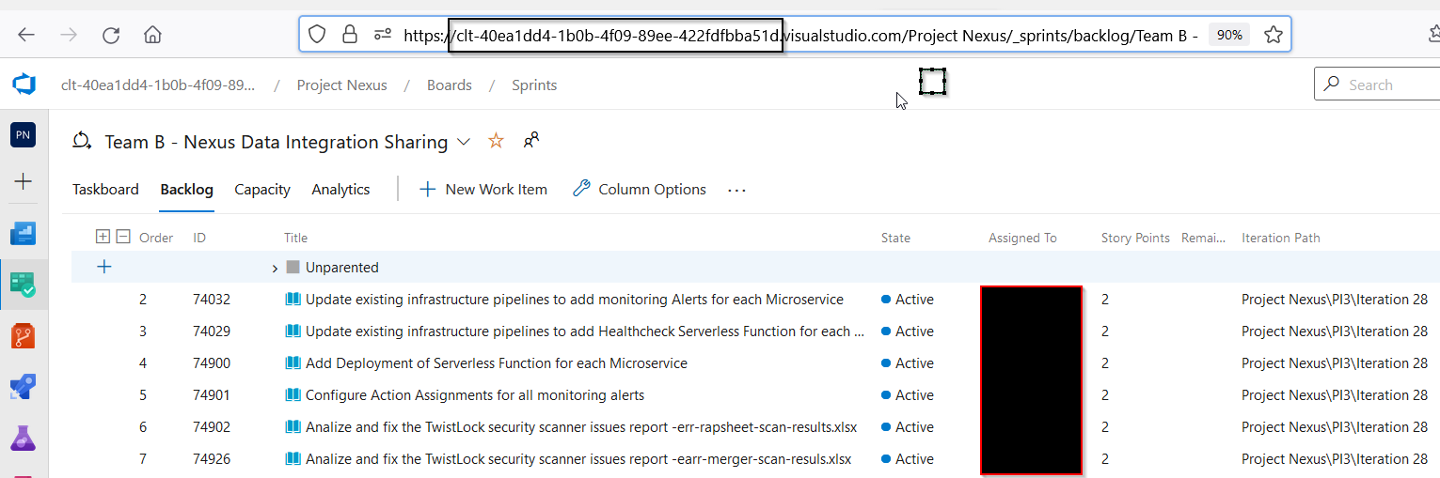

Slide 13
You'll need to understand the products available in each of these categories, and when you would use one instead of another:
Compute - Virtual machines, virtual machine scale sets, app services
Networking - virtual networks, load balancer, VPN gateway, application gateway, content delivery network
Storage - Blob, disk, file, archive storage and Azure Files
Databases - Cosmos DB, SQL Database, database migration service, SQL Data Warehouse
IoT - IoT Central, IoT Hub keywords: sensors, millions
Big Data - HDInsight, Data Lake Analytics Analytics implies big data
AI - Azure Machine Learning Service, Azure Machine Learning Studio
Serverless - Azure Functions, Logic Apps keyword: serverless
Identity services - identity concepts, Azure Active Directory, Multi Factor Authentication (MFA) concepts, IAM
Security products - including both the Azure Security Center, Information Protection, Advanced Threat Protection and security features in the product groups above, like Network Security Groups
Governance - including Policy and Role Based Access Control, but also compliance and privacy concepts.
Monitoring - Azure Monitor and Service Health
Azure tools - like Azure Resource Manager, Azure CLI, Cloud Shell and PowerShell

Slide 14
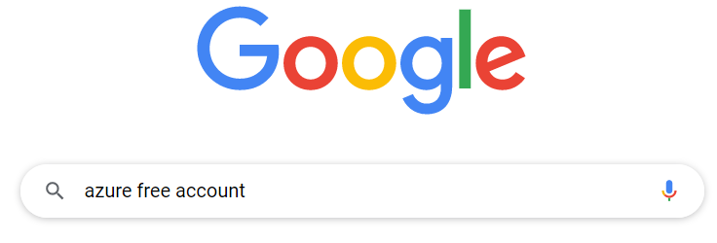
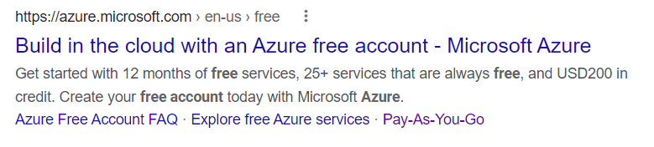
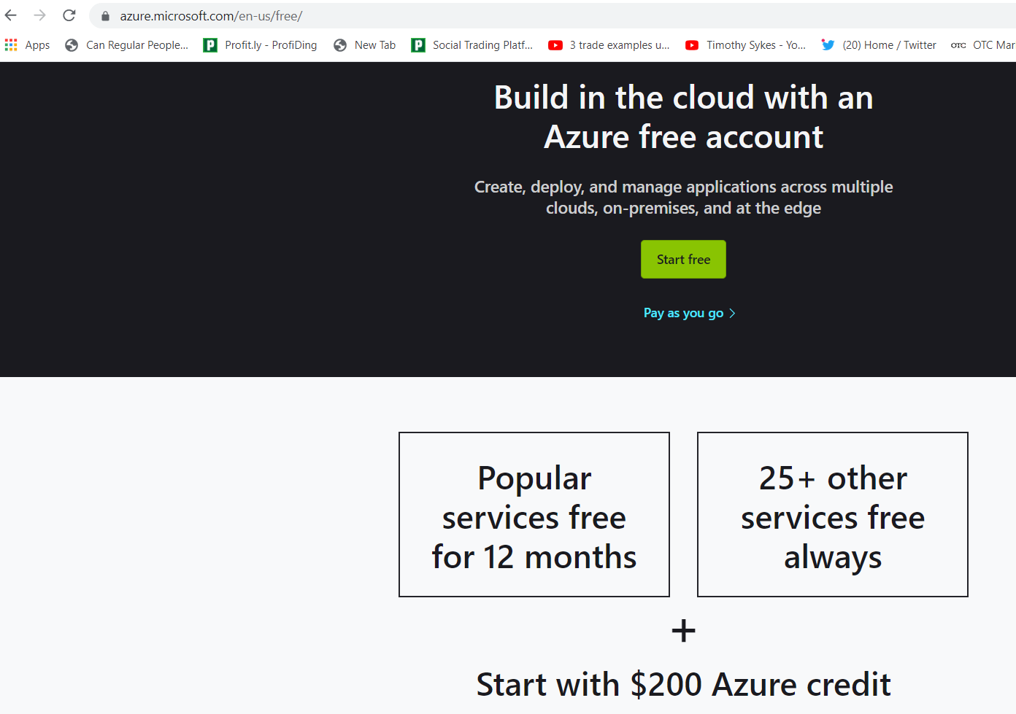
Azure Free Account
Why am I talking about this?
-understand converting Free to Pay-as-You-Go
MUST CONVERT
-understand limitations of Azure Free
NONE

Slide 15
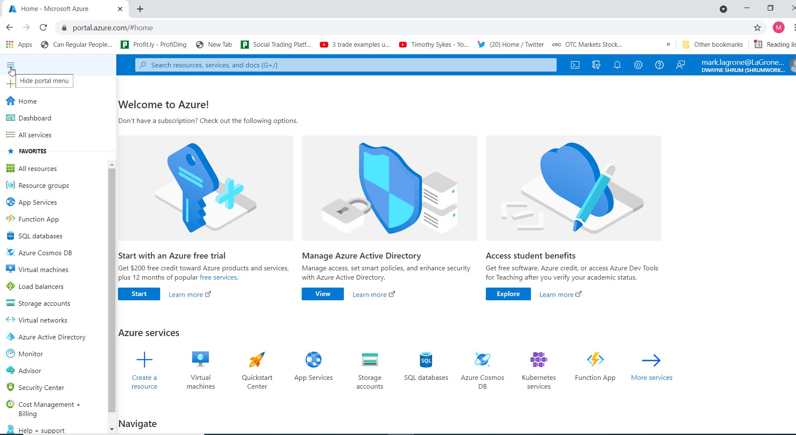
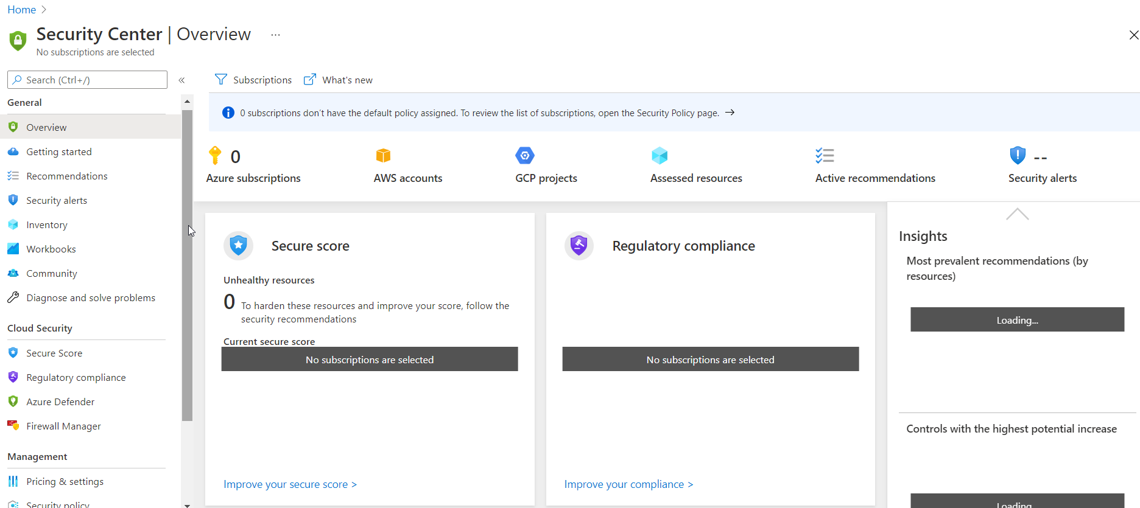
Security Center is not a Service but more of a location that you can view and manage other services. You need only have a perfunctory understanding.
Alerts: Security Logs, ie DDOS attempt, login attempts from diff locs by same user.
SECURITY CENTER
BLADES
Compliance : Provides a secure repository for you to upload and manage evidence and other artifacts related to your compliance activities.
(ie prove HIPPA compliance or GPDR)
Enables you to assign, track, and record compliance and assessment-related activities, which can help your organization cross team barriers to achieve your organization's compliance goals.
Firewall : Centralized configuration and management of multiple Azure Firewall instances, across Azure regions and subscriptions.
Some inherent Services: like DDOS

Slide 16
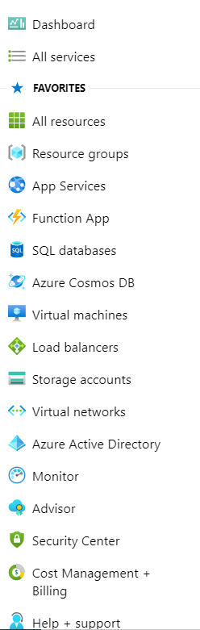
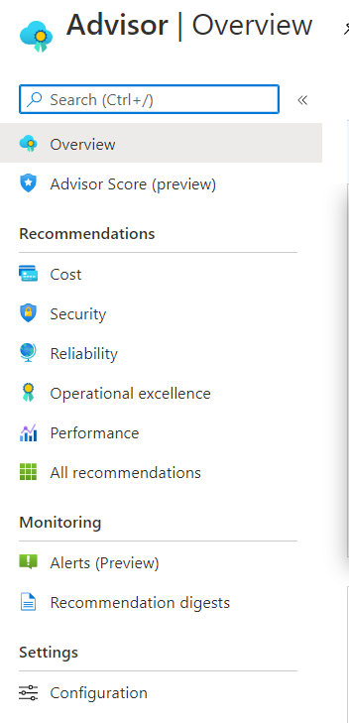
Understand what Advisor is/is not
Tool for assessing Cost (you have this on prem, cost if it were on cloud)
Security Assessment – identifies policy violations, does NOT fix.
Recommends ways to make things more redundant, suggest services
that may or may not assist you in reliability
Identifies potential performance bottlenecks – items perhaps that have
been throttled back and cause performance issues
Suggests process and workflow efficiency, resource manageability or
deployment best practices
MORE OF AN TOOL TO ANALYZE THAN TO FIX
BLADES

Slide 17
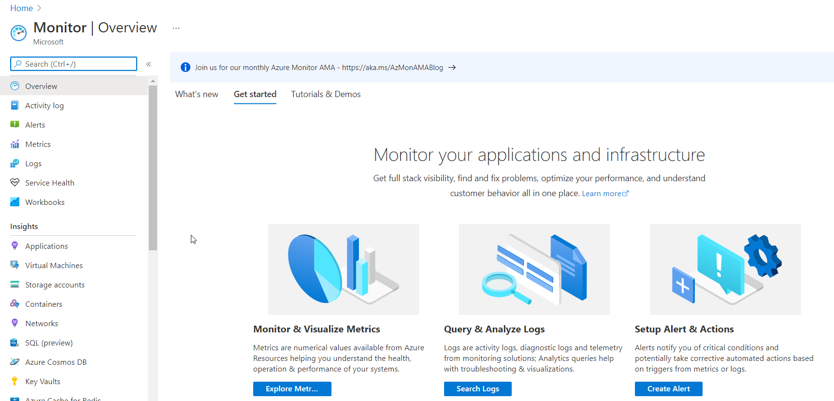
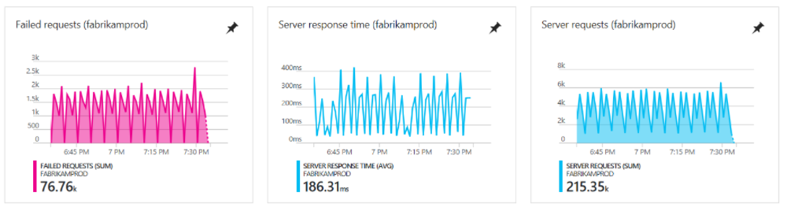
Metrics – you can set up various metrics and analyze how you are performancing against them
Activity Logs/Logs - you can monitor activity or just view Logs
Service Health – SLA, Uptime, Scheduled Outages etc…
Alerts – set up notifications when $ thresholds are being reached
Insights – logs on developed or deployed components

Slide 18
Resource Groups – logical collections of virtual machines, storage accounts, virtual networks, web apps, storage accounts, virtual machines, web apps, databases, and/or database servers. (Typically, users will group related resources for an application, divided into groups for production and nonproduction).
BLADES
Azure App Services (or Web Apps) lets you create apps faster with a one-of-a kind cloud service to quickly and easily create enterprise-ready web and mobile apps for any platform or device and deploy them on a scalable and reliable cloud infrastructure. Ie. ConverttoPDF.com, jibjab.com or Website App (create a website)
Azure Functions is a serverless solution that allows you to write less code, maintain less infrastructure, and save on costs. Instead of worrying about deploying and maintaining servers, the cloud infrastructure provides all the up-to-date resources needed to keep your applications running.

Slide 19
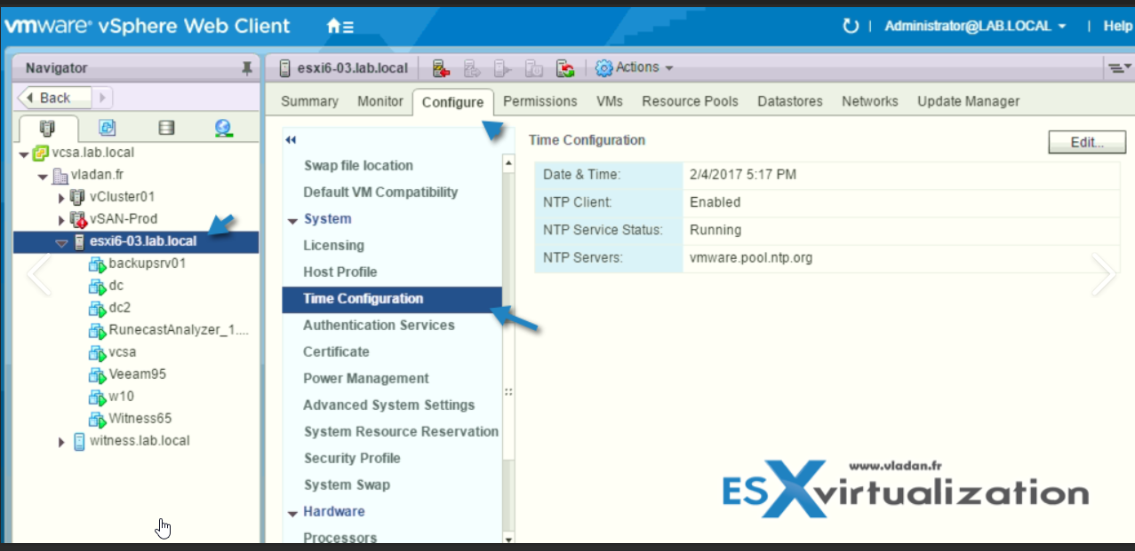
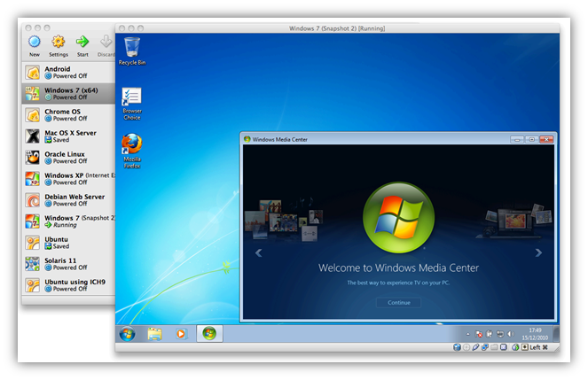
Virtual machines
BLADES
MAC OS
Why might I use a virtual machine?
-Running IIS (Windows based web manager or console)
-Running Apache (Linux based web service manager
-Interacting with many other custom programs, easier to
manage on one server
-Lift and shifting a server on-Prem to the Cloud
-Need the tools of a Windows or Linux machine to
perform a tasks – like connecting into network and testing:
Citrix and SOAPUI
Windows 7 running in MAC OS

Slide 20
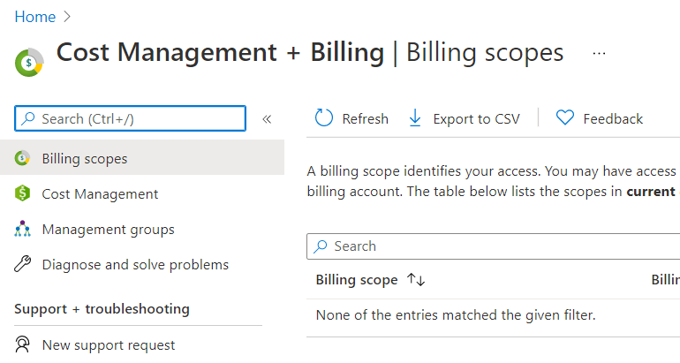
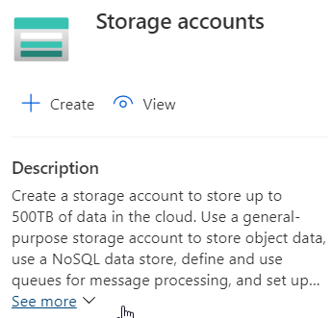
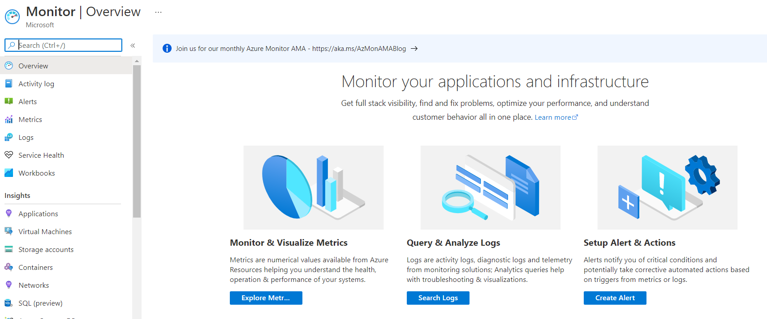
Point of management groups is to be able to
Manage different users in different tenants
In one place.
BLADES

